Slide 1
Warm Ups 03/27 - 04/07
Mrs. Ward, Team Broncos
Ridge Road Middle School

Slide 2
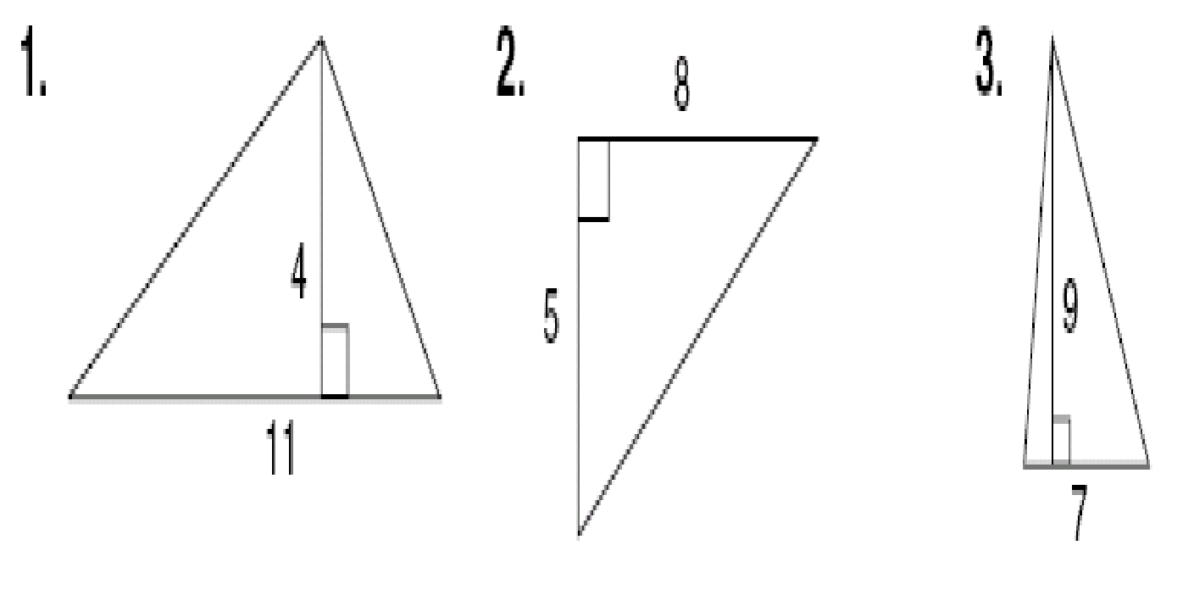
Warm-Up, Monday March 27
What is the formula to solve for the area of a triangle?
Find the area of the triangle below.

Slide 3
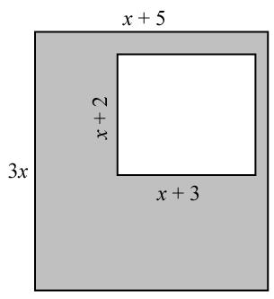
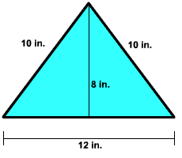
Warm Up Tuesday, March 28
What is the area of the shaded region of the object on the left?
What is the area of the triangle on the right?

Slide 4
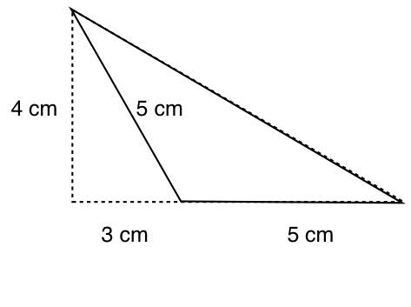
Warm Up Wednesday, March 29
What is the area of the solid figure?

Slide 5
Warm Up Thursday, March 30
When you are done…
Throwback Thursday 12
COMPLETE FIRST
Khan Academy
Find the area of the shaded region.

Slide 6
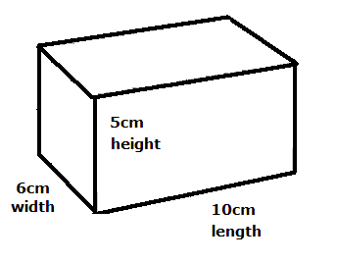
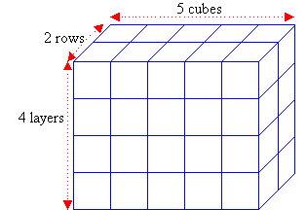
Warm Up Monday, April 3
Determine the volume and surface area of each shape below.
When you are done…
Throwback Thursday 12
COMPLETE FIRST
Khan Academy

Slide 7
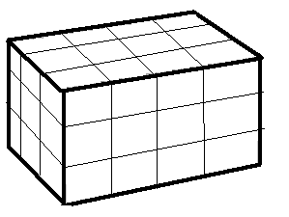
Warm Up Tuesday, April 4
When you are done…
Throwback Thursday 12
COMPLETE FIRST
Khan Academy
Each small cube below is 1 inches long.
Determine the volume and surface area of the shape.

Slide 8
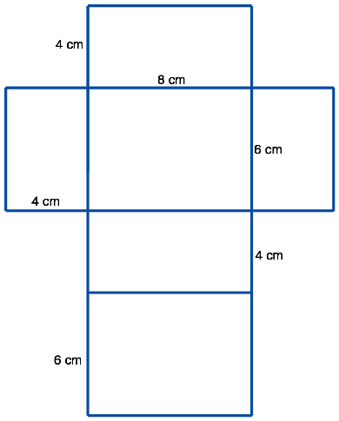
Warm Up Wednesday, April 5
Determine the surface area and volume of the rectangular prism. Be sure to include units in your answer.
When you are done…
Throwback Thursday 12
COMPLETE FIRST
LAST CHANCE!!!!!
Khan Academy

Slide 9
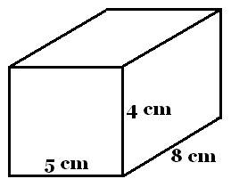
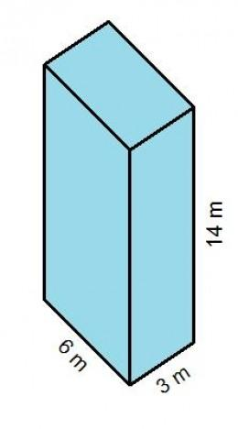
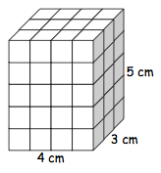
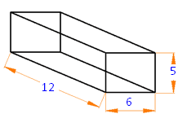
Warm Up Thursday, April 6
When you are done…
Take TBT 13
Khan Academy 20
Determine the surface area and volume of the rectangular prisms.

