Slide 1
Warm Up Set 13
Anna Ward
Ridge Road MS

Slide 2
Warm Up
04/17
Grab warm up tracker
Grab HW
Put TEST in bin (if complete)
Khan Academy

Slide 3
Warm-Up
04/18
Retake TBT 13
Khan Academy
Work On Notebook
PUT TEST IN BIN!!!!

Slide 4
Warm Up
04/19

Slide 5
Warm Up
04/20

Slide 6
Warm Up
04/21
Put HW in Black Bin
Turn in any late Take-Home tests in Gray Bin
Start Throwback Thursday 14

Slide 7
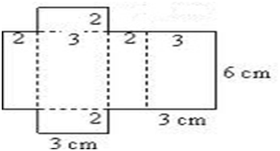
Warm Up 04/24
Warm Up
TBT 14
Khan Academy
What shape will this make when folded back up?
What is the surface area of this shape?
What is the volume?

Slide 8
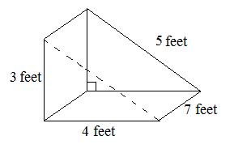
Warm Up 04/25
What is the name of this object?
Sketch what it would look like as a net.
What is the surface area of this shape?

Slide 9
Box Plots Notes (Item 92)
Order the data set least to greatest
Divide the set in half
Find the median (2nd quartile)
Find the 1st quartile (divide first half in half)
Find the 3rd quartile (divide the second half in half)
Create a box using quartiles
Create whiskers using least and greatest numbers.

Slide 10
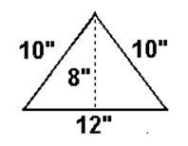
Warm Up 04/26
What is the formula for the area of a triangle?
What is the perimeter of the triangle?
What is the area of the triangle?

Slide 11
Warm Up 04/27
What is the MEAN ABSOLUTE DEVIATION of the following numbers? 50 100 55 95 98 52 75
HINT: USE PAGE 93 of your notebook!!!
After you are done, you MUST work on Throwback Thursday 15 before moving on to Khan!!!!

Slide 12
ITEM 94: IQR and finding the missing value of an average
What is IQR?

Slide 13
ITEM 94
Janelle scored a 75, 100, 90, 80, 83 on her quizzes. What would she need to score on her last quiz if she wanted to receive an average of 85?

Slide 14
Agenda for today:
NEARPOD: MUST BE COMPLETED TODAY!!! CODE: SKTYA
Vocabulary HW DUE tomorrow
Statistics Choice Board due Friday at the end of class

Slide 15
Warm Up 04/28
Data set: 13, 19, 21, 2, 5, 6, 3
What is the mean?
What is the mode?
What is the range?
What is the median?
What is the IQR?
Complete a box plot with the data set.
What is the MAD?

