Slide 1
Warm Up Set 7

Slide 2
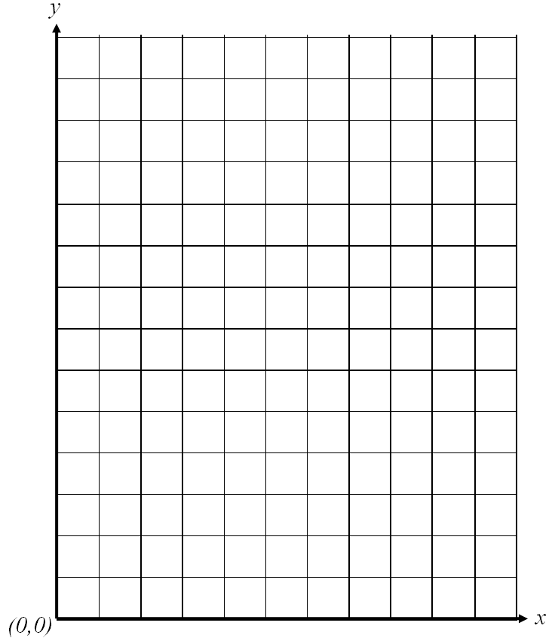
Warm-Up
Monday, December 12
x | y
0
1
2
3
10
Equation: y = 5x + 2
Complete the chart
Make a graph
Explain patterns you observe
If x=20, then what is y?

Slide 3
Warm-Up
Tuesday, December 13
x | y
0
1
2
3
10
y is equal to three more than the product of 4 and x.
Equation: __________
Complete the chart
Make a graph
Explain patterns you observe
If x=20, then what is y?

Slide 4
Warm-Up
Wednesday, December 14
Write an inequality and graph the following scenarios:
I posted at least 25 pictures on Instagram.
There were at most 1,500 people at the Beyonce concert.
More than 18 students did their homework last night.
Can I borrow up to $10.00?
I slept less than 5 hours last night.

Slide 5
Warm-Up
Thursday, December 15
Write an inequality and graph the following scenarios:
It is below 50 degrees outside.
Beyonce has over 3,500,000 Twitter followers.
No more than 150 students can be in the media center at once.
Fewer than 175 road the train.
We played video games for at least 7 hours over the weekend.

Slide 6
Warm-Up
Friday, December 16
Write an inequality, solve and graph the following scenario:
Jadelice went to the candy store. She has up to $60 to spend on treats for her friends. She’s already spent $34 on Air Heads. If Ring Pops cost $2 a piece, how many could she purchase?
DO NOT USE NUMBER SENSE TO SOLVE THIS.
I WILL YELL AT YOU!!!!!!!!!!!!!!!!!!!!!! :)

Slide 7
Warm Up
Monday, December 19
Work on:
Khan Academy
Light up the Room Virtual Lab (Discovery Education)
Light Energy Vocabulary 2 and 3
Light Crossword

Slide 8
Warm-Up
Tuesday, December 20
Write an inequality, solve and graph the following scenario: Kerry was saving for a vacation to Disney World. She needs a total of $900 to take a trip. Her grandmother has already paid $200 for her deposit as a present. She has one week to earn the additional amount. How much she earn per day to take her vacation?

Slide 9
Warm Up
Wednesday, December 21
Walter and his four friends need at most $74.50 to buy a video game. Walter already paid $37.10. If his friends are equally paying the remaining amount, how much should each person pay? Write, solve, and graph an inequality that represents this situation.

Slide 10
Bob and his five friends need at least $200 to purchase tickets to Scarowinds. Bob already paid $18. If each friend is going to pay the remaining cost equally, how much does each friend need to pay?

