Slide 1
Warm Up Set 9
January 23 - February 3

Slide 2
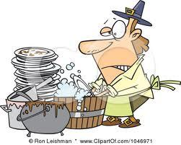
Monday, Jan 23
May Do:
Khan Academy
Week 13 HW
Any Make-up work
Warm Up:
1. Kim does the laundry every 12 days and Jim washes the dishes every 5 days. How many days will pass until both Kim and Jim are doing laundry and the dishes on the same day?
2. Place the following values on a number line. Which value is the smallest and which is the biggest? Be sure to show your work.
a) 2/9 b) 2.9 c) 29%
3. Which option below is the best deal? Be sure to explain your answer.
Option A: Two movies for $7.12
Option B: Six movies for $17.34

Slide 3
Tuesday, Jan 24
May Do:
Khan Academy
Week 13 HW
Any make up work
Warm-Up:
Solve the following problems below by using the values from the variables above.
A + B
2. A – B
A = 12 | B = 3.4 | C = 56 | D = 733.6
3. BC
4. D
C

Slide 4
Wednesday, Jan 25
May Do:
Khan Academy
Week 14 HW
Science HW
Read
Damian has $100
1. Damian spent $34.78. How much money does he have now?
2. With the money he now has, Damian took three hundred twenty one dollars and twenty three cents out from the bank. How much money does he now have?
3. With the money he now has, he splits it evenly among five friends. How much money does each friend receive?
4. One of his friends took his money and tripled his money after winning a contest. How much money does his friend have now?

Slide 5
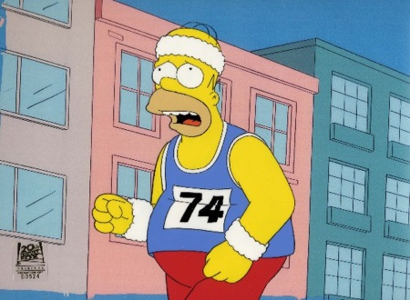
Thursday, Jan 26
May Do:
SEE SIDE BOARD….
DO NOT WASTE ANY TIME!
1. Six footballs cost $301.68. At this rate, how much does each football cost?
2. Solve the following problem below when d=6, c = 3, b = 0.5.
45 ÷ (d + c) • b³
3. Homer Simpson ran ‘y’ miles and Bart Simpson ran five fewer than half that amount. Write an expression that represents this situation.
4. According to the problem above if Homer ran 12 miles, how many miles did Bart run?

Slide 6
Friday, Jan 27
1. When solving the expressions below, let x = 4/5 and y = 1 and 2/3.
a) xy
b) x ÷ y
2. A light post is 10 feet high and cast a shadow that is 8 feet long. If a nearby light post cast a shadow of 12 feet long, how tall is the light post?
3. What is the value of z in the following equation?
z + 1.1 = 20 3
May Do:
Khan Academy
Sound Pathway
Re-do Throwback Thursday Quiz

Slide 7
Monday, Jan 30
May Do:
Khan Academy
Week 15 HW
Notebooks
What are factors?
What are common factors between numbers?
What is meant by the greatest common factor (GCF)?
Come up with your own example.

Slide 8
Tuesday, Jan 31
May Do:
Khan Academy
Week 15 HW
Test Corrections
Mary has 54 smiley stickers and 36 glittery stickers. If she wants to divide the stickers evenly among her friends so that each friend gets the same amount of smiley stickers, the same amount of glittery stickers, and no stickers leftover, what is the greatest amount of friends Mary can have to divide her stickers?

Slide 9
Wednesday, Feb 1
May Do:
Khan Academy
Week 14 HW
The restaurant’s two neon signs are turned on at the same time. Both signs blink as they are turned on. One sign blinks every 9 seconds. The other sign blinks every 15 seconds. How many seconds will it take for both to blink together?

Slide 10
Science Starter 02/01
Get out your science notebook.
Create the title page of your next unit. This is UNIT 6, “Structure of the Earth”
Create your next Table of Contents for the Unit.
Item 73 Science Starters (Leave 2 pages)
Structure of the Earth Vocab 1
When you are done, you can work on Khan Academy Set 12, math corrections, or any missing work.

Slide 11
Thursday, Feb 2
May Do:
Khan Academy
Week 15 HW
6 and 18
What are the factors of each number?
Are there any common factors?
What is the greatest common factor (GCF)?
What are the multiples of each number?
Are there any common multiples?
What is the least common multiple (LCM)?

Slide 12
Science Starter 02/02 (ITEM 73 in NB)
YOU MUST WRITE THE QUESTION! :)
What is the name of the center of an atom?
What type of charge does an electron have?
What is the name of a particle with more than one atom combined?

Slide 13
Friday, Feb 3
May Do:
Khan Academy
Week 15 HW
Throwback Thursday 4
What is the goal of the number system?
Graph the following points using letters on a number line.
Three more than -1
The opposite of 5
8.7
Three less than -6
The absolute value of -10
|9|
|-1|

Slide 14
Science Starter 02/03 (Item 73)
What are the three forms of heat transfer?
What is conduction?

