Slide 1
Warm Ups Set 8
January 4 - 20

Slide 2
Wednesday, January 4
May Do’s:
Khan Academy
Dream Box
Organize Science Notebook
MUST DO:
Come in, find your new assigned seat (Flight Log)
You should find a post it on your desk. Think of one goal you’d like to accomplish by January 23 (end of the quarter) and record it on your post-it.
On your new Warm Up Tracker, answer the following questions:
Is 3x + 4 = 11 an example of an expression, equation, or inequality? How do you know? Can this be solved? If so, what is the answer?
Is 3x +4 an example of an expression, equation, or inequality? How do you know? Can this be solved? If so, what is the answer?
Is 3x +4 > 11 an example of an expression, equation, or inequality? How do you know? Can this be solved? If so, what is the answer?

Slide 3
Thursday, January 5
MUST DO:
Come in silently and find your seat.
Get out your tracker and answer the following questions on your sheet:
⅞ + ⅙ =
⅞ - ⅙ =
⅞ ● ⅙ =
⅞ ÷ ⅙ =
May Do’s:
Khan Academy
Math Test Reflections
Organize Science Notebook

Slide 4
Friday, January 6
May Do’s:
Khan Academy
Organize Science Notebook
Any missing assignments
Test Corrections & Reflection
MUST DO:
Marco and 10 of his friends needed to collect $1500 to complete a kayaking and ropes trip at the White Water Center. They have already paid $400 as a deposit. What is the minimum amount each of the friends needs to contribute to pay the balance? Please write an inequality. Solve the inequality. Graph the inequality. And then you will be done...with the warm up, at least. :)

Slide 5
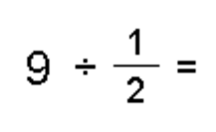
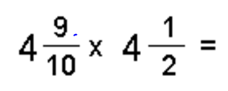
Wednesday, Jan 11
Today’s topic: multiplying and dividing fractions
Write down homework in agenda.
Show me or turn in any late work.
Complete the following problems on your warmup sheet:
B. c. c.
When you’re finished:
Update and organize science notebook
Khan Academy
Math Vocab

Slide 6
Independent work group
Teacher group
Go to schoolnet and type in the code: KU3GU2
Complete the 15 questions by giving your BEST EFFORT.
Khan Academy
Math Vocab
Have out your INB and a pencil

Slide 7
Thursday, January 12
CALCULATE THE VALUE. DO NOT FORGET TO SIMPLIFY AND BOX YOUR ANSWER.
May Do’s:
Khan Academy
Organize Science Notebook
Math Vocab
Science HW

Slide 8
Science Starter
Grab a copy of the Sound Vocab...get started!

Slide 9
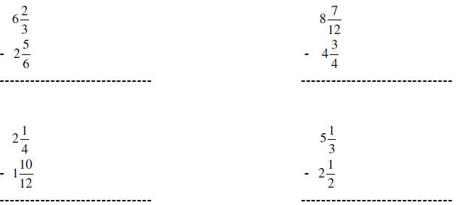
Friday, January 13
May Do’s:
Khan Academy
Math Vocab

Slide 10
Tuesday, 01/17
MUST DO:
May Do:
Khan Academy
Math HW

Slide 11
Wednesday, 01/18
MUST DO:
May Do:
Khan Academy
Math HW

Slide 12
Thursday, 01/19
12.19 + 4.6
463.69 - 19.92
0.0041 + .22

Slide 13
Friday, 01/20

