Slide 1
Warm Ups Set 11
March 13 - March 24
Mrs. Ward, Team Broncos

Slide 2
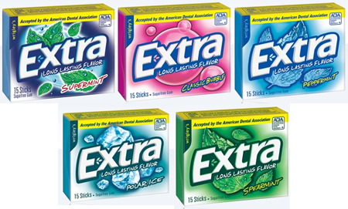
Warm Up 03/13
May Do:
Khan Academy 17
Week 19 HW
Retake TBT 9
1. If the cost of 10 packs of gum is $15.00, how much will 15 packs of gum cost?
2. Come up with a unit rate for the problem above.
3. Are the following ratios proportional? Prove your answer.
4 and 6
6 9

Slide 3
Warm Up 03/14
May Do:
Khan Academy 18 (new set)
Week 19 HW
Retake TBT 9
Gavin, Michelle, and Rachel went to Pizza Hut. Gavin ate a fourth of a pizza, Michelle ate 75% of a pizza, and Rachel ate 0.50 of a pizza. If a pizza has 16 slices and they purchased 2 pizzas, how many slices remain? Explain your answer.

Slide 4
Warm Up 03/14
May Do:
Khan Academy 18 (new set)
Week 19 HW
Retake TBT 9
Gavin, Michelle, and Rachel went to Pizza Hut. Gavin ate a fourth of a pizza, Michelle ate 75% of a pizza, and Rachel ate 0.50 of a pizza. Who ate the least?

Slide 5
Warm Up 03/15
May Do:
Khan Academy 18
Week 19 HW
Retake TBT 9
1. If 6 dogs weigh 15 pounds, how much does each dog weigh? How much do nine dogs weigh?
2. Dayana has less than twenty-five dollars in her pocket. Write and graph this inequality.
3. Jack did 50 tricks on his skateboard and Jill did 25 on hers. If they fell 2/3 of the time, how many times did they not fall?

Slide 6
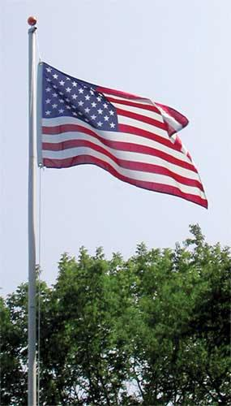
Warm Up 03/16
May Do:
Khan Academy 18
Week 19 HW
Test Corrections
A flag pole has a height of 20 feet and it casts a 40 foot shadow. If there is a nearby tree that is 55 feet tall, how long is its shadow? Draw a picture to help solve this problem.

Slide 7
Warm Up 03/17
When you are done:
Khan Academy 18 (DUE TUES)
Take or retake TBT 10
PLACE HW IN THE BIN!!!!
Evaluate the product of 0.88 and 1.2?
Jim eats five slices of pizza every two weeks. At this rate how many slices will he eat in 9 weeks?
Solve and graph the inequality below.
8a – 12.6 > 9

Slide 8
Warm Up 03/17 BLOCK 3
May Do:
Khan Academy 18
Week 19 HW
Retake TBT 10
Evaluate the product of 0.88 and 12?
Jim eats five slices of pizza every two weeks. At this rate how many slices will he eat in 9 weeks?
Solve and graph the inequality below.
8a – 15 > 9

Slide 9
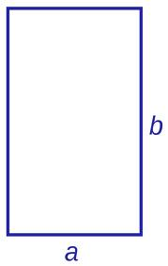
Warm Up 03/20 (MONDAY)
HW IS ON THE CHROMECART
May Do:
Khan Academy 18
Week 20 HW
Retake TBT 10
If a = 4.1 inches and b = 11.3 inches,
What is the area of the rectangle?
What is the perimeter?
If a = 5/12 feet and b = 4/6 feet,
3. What is the area of the rectangle?
4. What is the perimeter?

Slide 10
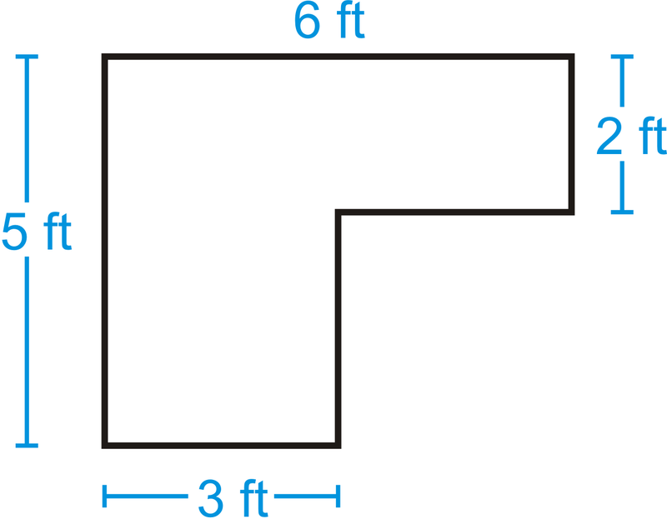
Warm Up 03/21 (TUESDAY)
Complete when done:
Complete Vocab Sheet 79
Complete What is area? 80
Retake TBT 10
What is the area and perimeter of this shape?
IF you do NOT know the answer, write out the problem and picture.
DO NOT GET OUT YOUR CHROMEBOOK UNTIL Warm Up, Item 1, and Item 2 are completed.

Slide 11
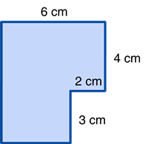
Warm Up 03/22 (WEDNESDAY)
May Do:
Khan Academy 19
Week 20 HW
Retake TBT 10 (LAST CHANCE)
What is the area and perimeter of this shape?

Slide 12
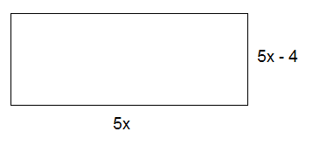
Warm Up 03/23 (THURSDAY)
When you are done:
Take TBT 11
Khan Academy 19
What is the area and perimeter of this shape?

Slide 13
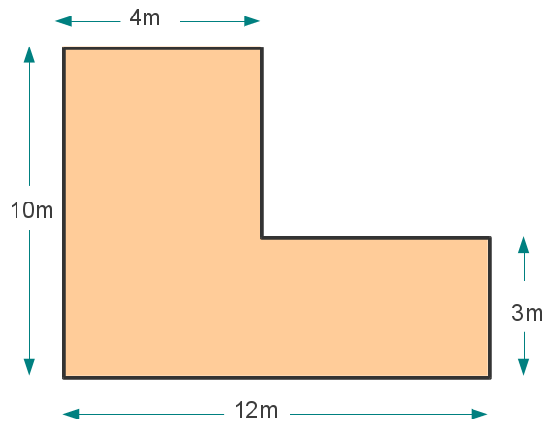
Warm Up 03/23 (THURSDAY)
When you are done:
Take TBT 11
Khan Academy 19
What is the area and perimeter of this shape?

Slide 14
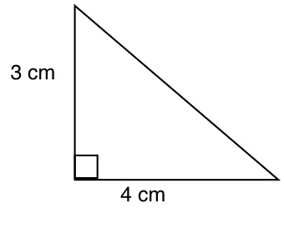
Warm Up 03/24 (FRIDAY)
May Do:
Khan Academy 19
Test Corrections
Retake TBT 11
What is the area of this shape?

